Slide 1

Data Mining
Individual Project 1

Slide 2
TASK
Compare
Compare Overall Military spending to Country’s GDP
Compare
Compare Military spending in absolute dollars versus relative to GDP
Compare
Compare the per person Military spending to the per person GDP
Single out
Single out the fastest growing countries in Military spending in absolute and relative terms
Find
Find Dataset, clean data and single out ten G20 Countries only

Slide 3
Data Source
The three datasets used in this project were sourced from the World Bank. All credits for data is attributed to the World bank and the url links are included.
GDP Data
Military Data
Population Data

Slide 4
Data Preprocessing
The three datasets used here include world GDP data,
Population data and Military Spending data in CSV format.

Slide 5
Pandas, Matplotlib, Numpy
Libraries Used
Read in the csv files using pandas
Filtered out unnecessary dates
Deleted unwanted columns from the datasets
Renamed columns for easy merging and manipulation
Checked for null values in the dataset
Merge the three datasets using a SQL like inner join preserving the order of the left join.

Slide 6
The 10 countries of interest
Australia
China
Germany
France
UK

Slide 7
The 10 Countries of interest
Italy
Korea
Russia
Saudi Arabia
United States

Slide 8
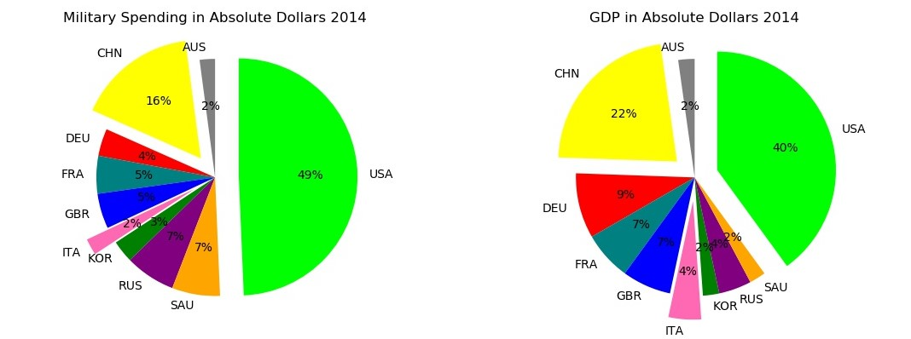

Slide 9
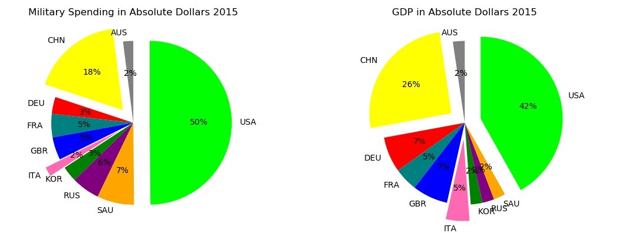

Slide 10
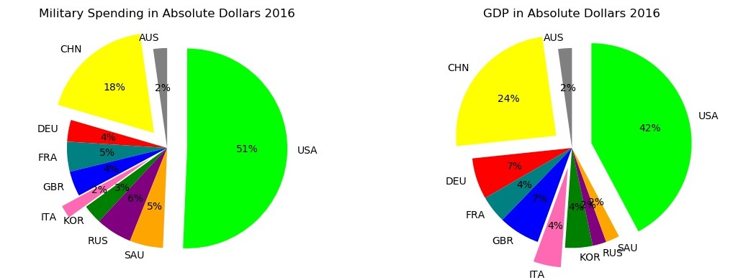

Slide 11
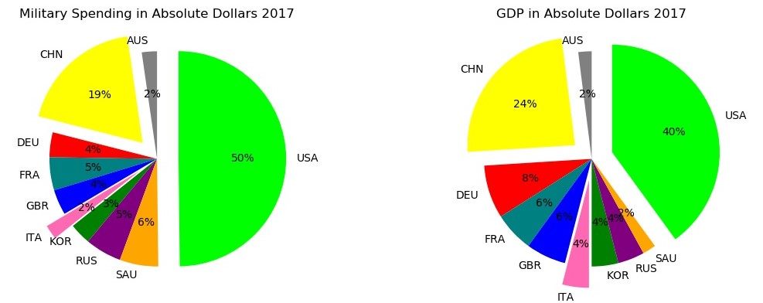

Slide 12
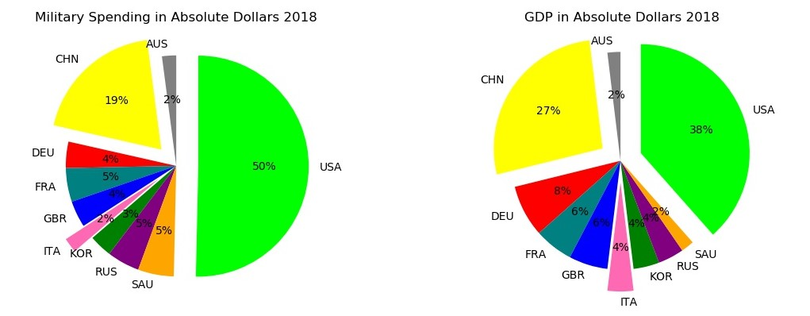

Slide 13
ABSOLUTE MILITARY SPENDING VS. RELATIVE MILITARY SPENDING

Slide 14
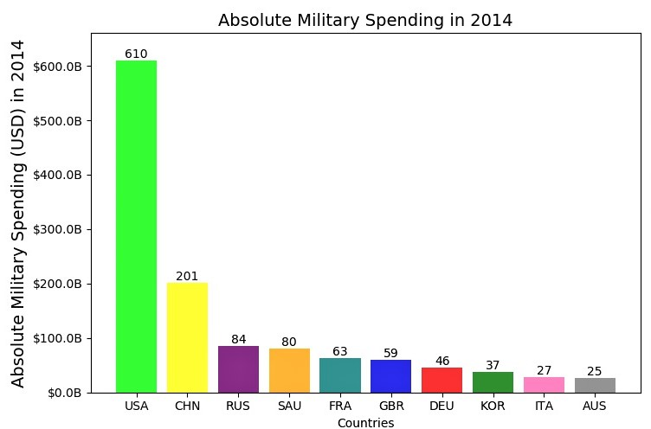
Absolute Military Spending 2014
We see the USA leading the pack in military spending in absolute dollars followed by China and Russia. This pattern repeats itself in the subsequent 4 years after.

Slide 15
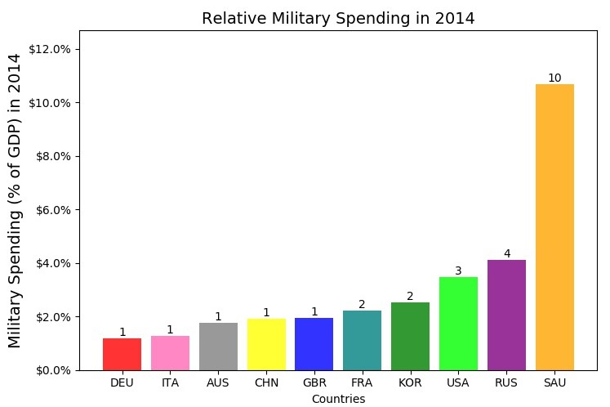
RELATIVE MILITARY SPENDING 2014 We see a new trend here with Saudi Arabia spending the most as a percentage of GDP followed by Russia and the USA. This remains the same pattern in the subsequent four years.

Slide 16
absolute vs. relative military spending per person

Slide 17
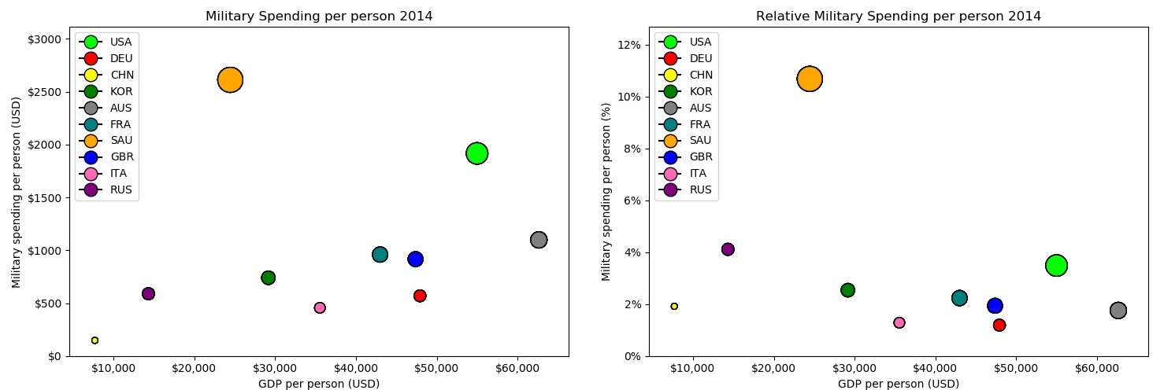
We see Saudi Arabia spending the most of its income on the military followed by Russia and the USA. On the other hand we have countries like Italy and Germany spending the least.

Slide 18
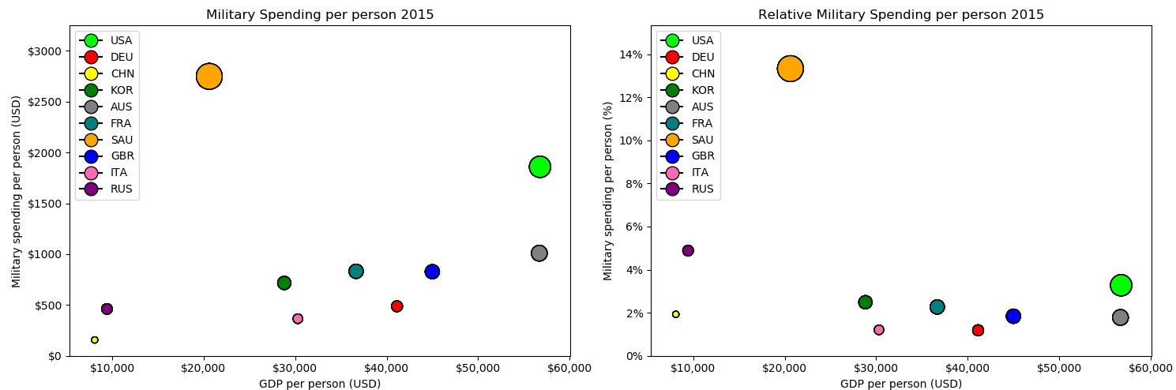
In 2015,we see Saudi Arabia spending the most of its income on the military followed by Russia and the USA. On the other hand we have countries like Italy and Germany spending the least.

Slide 19
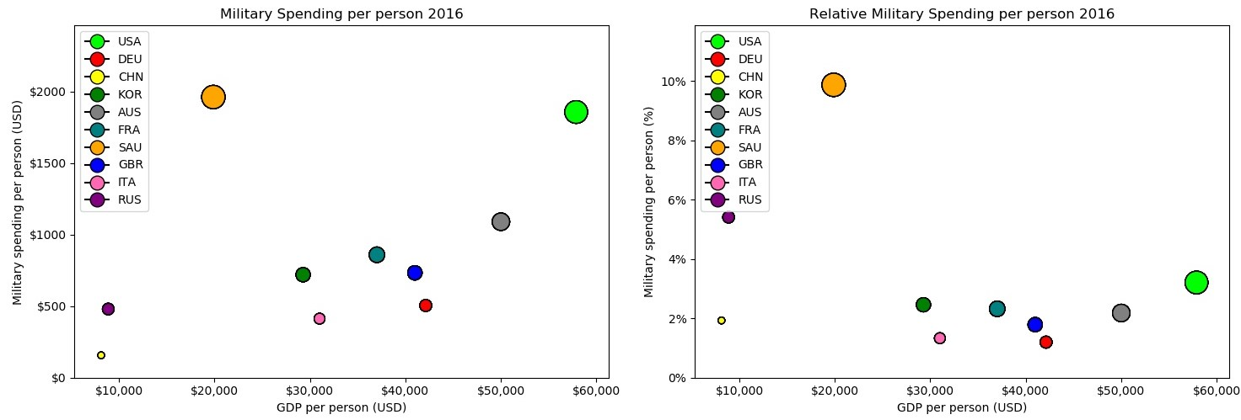
In 2016 we see a similar trend with Saudi Arabia spending the most of its income on the military followed by Russia and the USA. On the other hand we have countries like Italy and Germany spending the least.

Slide 20
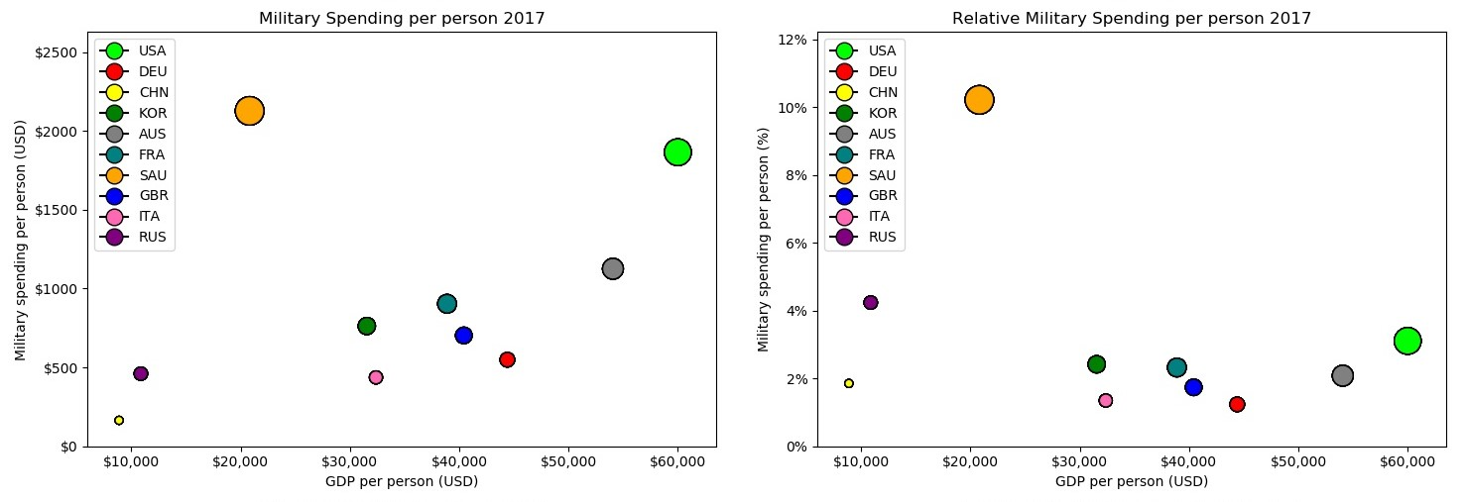
In 2017, we see a slight drop in percentage in Russia’s spending but still made it to the top 3. Saudi Arabia spent the most followed by Russia and the USA. The rest maintaining their previous positions.

Slide 21
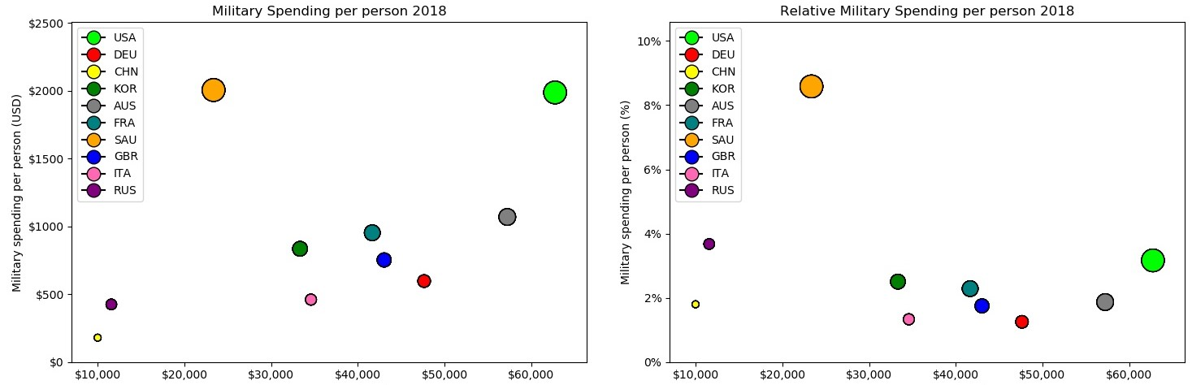
We see a similar trend in 2018 with no dramatic changes.

Slide 22
FASTEST GROWING COUNTRIES IN MILITARY SPENDING

Slide 23
We see four different trends here
China has been progressively increasing its military spending the last six years, spending more money as its GDP grows.
Three European countries; Germany, France and Italy starting in the year 2016 has been increasing its military spending as a result of the pressure from the United States for European countries to pay up in NATO.
The United States has seen an increase in its military spending starting in 2016 when the Republican government came into power.
South Korea has also seen a gradual and steady increase in its military spending since 2016.

Slide 24
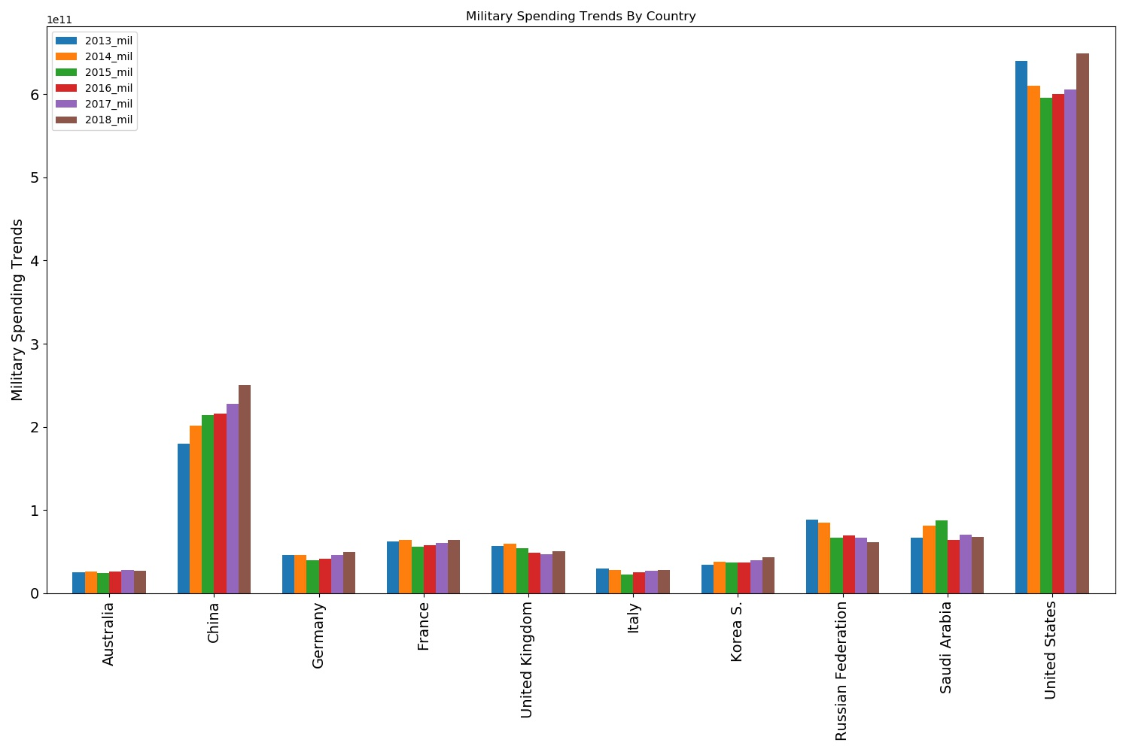

Slide 25
Fastest growing countries in military spending percentage change
China is the only country has not seen a negative trend that it has not seen a relative decrease year over year.
The Three European countries; Germany, France and Italy starting started to witness a positive relative increase starting in 2016.
The United States has seen a positive relative increase since 2016 as well.
South Korea has witnessed a positive relative increase in its military spending since 2016

Slide 26
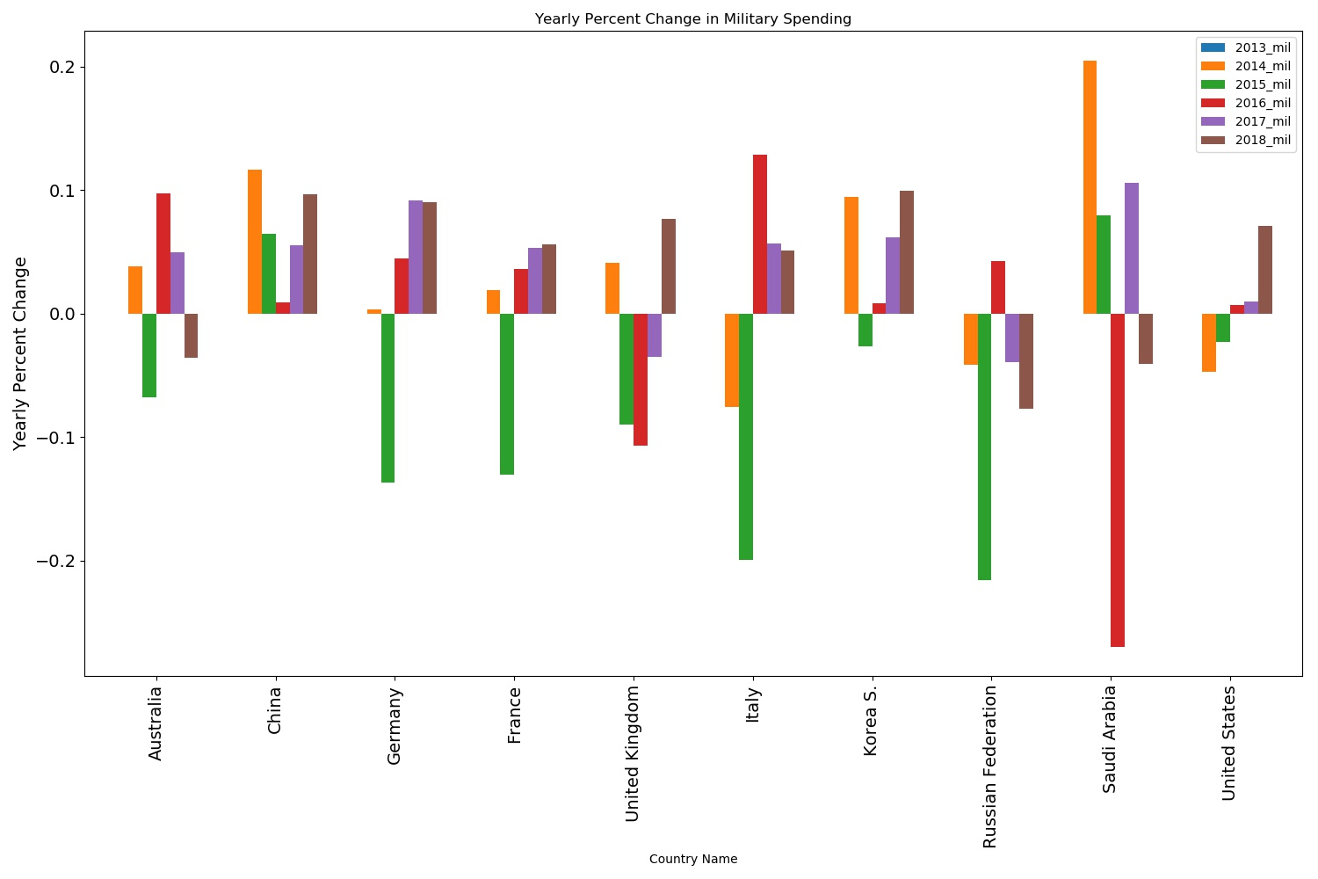

Slide 27
PREDICTIONS
China remains the most consistent upward trending country in military spending and will continue to increase its military spending as its GDP grows and as its overall impact in the world increases.
The United States will witness an increase in military spending when its foreign policy is to project military strength which is mostly under Republican rule.
South Korea will also continue to see an increase because it has technically being at war with its neighbor North Korea.

Slide 28
CONCLUSIONS
There are different reasons driving military spending for different countries, amongst them are foreign policy, regional position or location, GDP growth and its domestic politics. We see that countries that make more money tend to spend more money on its military except a few countries that as a matter of survival based on the region they are located they have to spend more money on their military.

